Slide 1
AI-Powered Semantic Matching System for Candidate-Job Ranking

Slide 2
Project Overview
Goal & Problem Statement
Data Collection, Preparation & Feature Engineering
Semantic Scoring and Overall Score Calculation
Test Dataset Generation and Model Training
Model Evaluation & Performance Predictions
Key Takeaways
Future Enhancements

Slide 3

GOAL
Automate and enhance candidate
shortlisting by calculating the semantic relevance of candidates to job roles.
Understand how relevant a candidate is to a job beyond keywords-Semantic analysis
Generate a rich feature set using profile info You have full profiles
Train a strong ML model to rank candidates for each job XGBoost is perfect
Test that model on new jobs & candidates

Slide 4
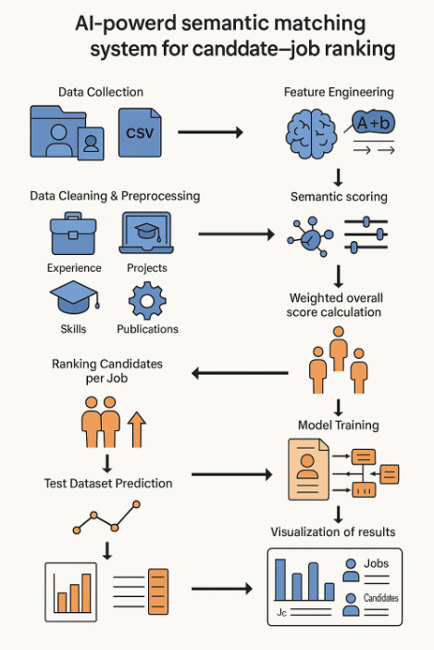
Flow

Slide 5

Problem Statement
Manual resume screening is inefficient and often biased.
Traditional keyword-based systems lack context and semantic understanding.
A semantic model is needed to assess candidate-job compatibility more intelligently.

Slide 6
Data Collection & Preparation
Sources: Candidate profiles and job descriptions stored in structured CSV format.
Candidate Fields: Experience, Projects, Education, Skills, Publications.
Job Fields: Responsibilities, Qualifications, Skills.
Data Cleaning: Addressed encoding issues, filled missing values, normalized and preprocessed text fields.

Slide 7
Feature Engineering
Parsed and cleaned relevant sections from text fields using regex.
Extracted standardized components from nested entries (e.g., experience, skills).
Prepared domain-specific semantic comparison inputs.

Slide 8
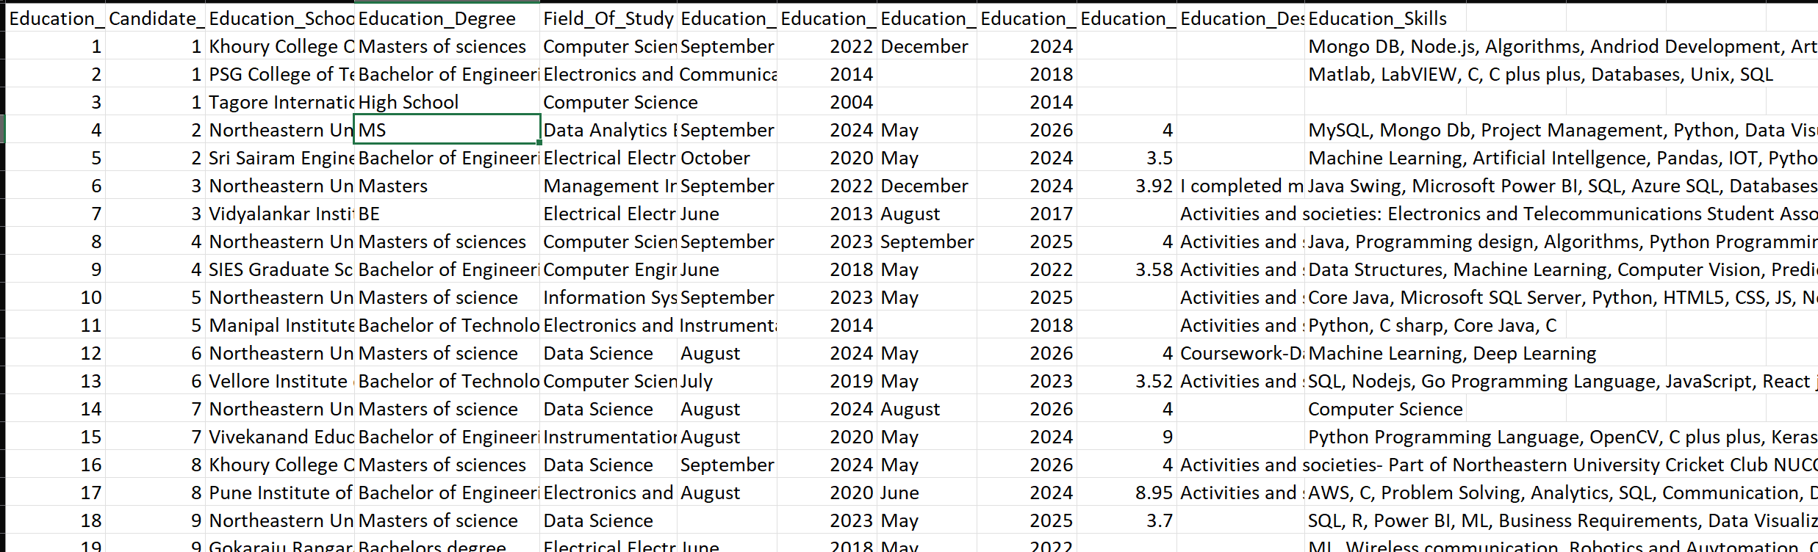
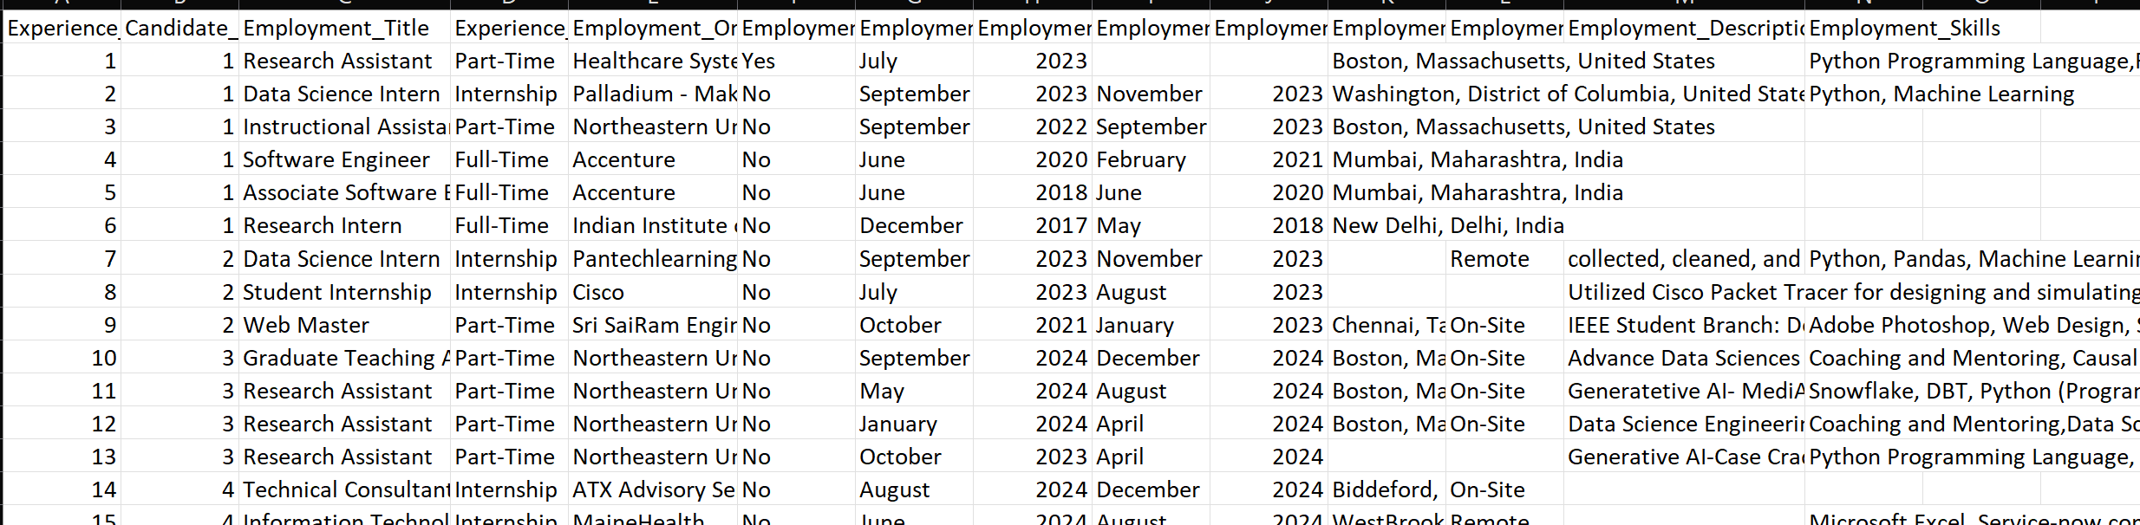
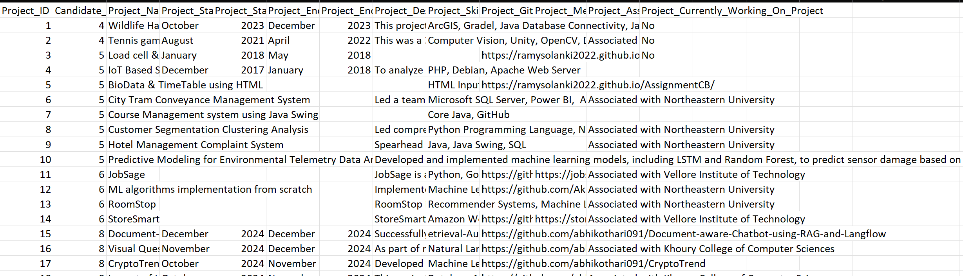
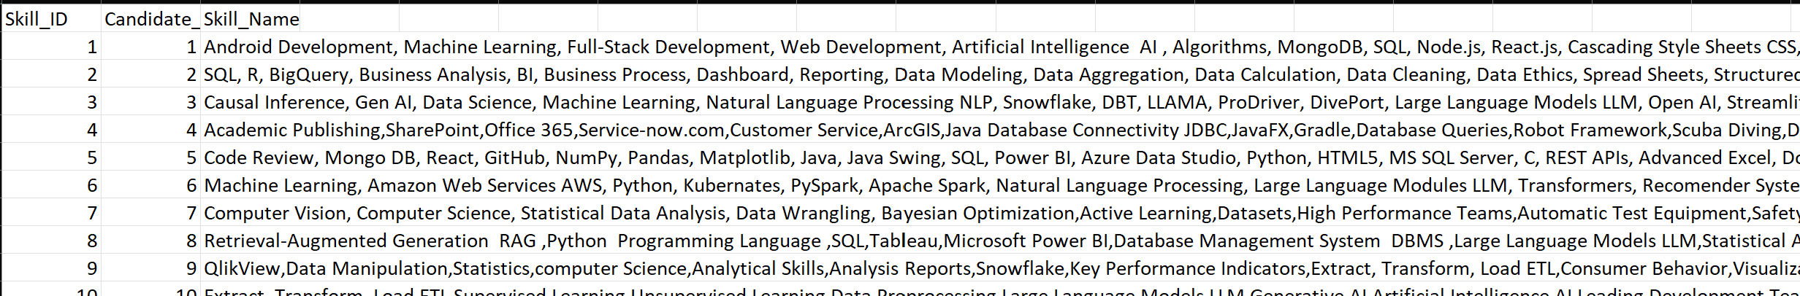

Slide 9
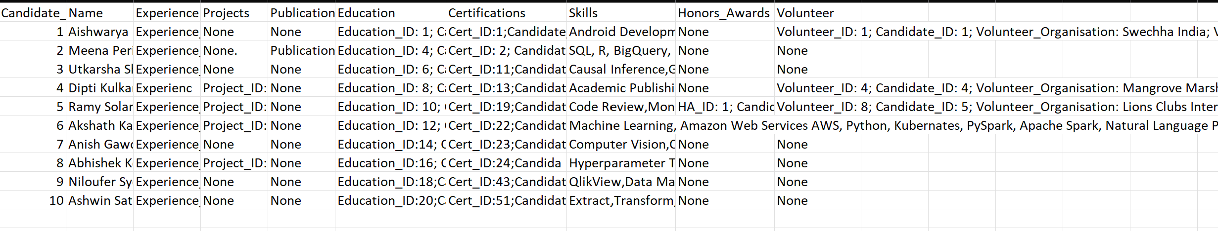
Aggregated and the cleaned and processed data in a single excel sheet for easy read and write.
Cleaning and formatting changes:
1. Separated each project/experience/skills using a semicolon for slicing purpose for each candidate
2. Removed unnecessary keyword from descriptions for each section to reduce noise and purify data for semantic accuracy.
3. Replaced black cells with no data with “None” to avoided system failure/code crash.

Slide 10
Effective delivery techniques used in MVP
Semantic Scoring Using Sentence-BERT Ensemble.
Models Used
all-mpnet-base-v2
intfloat/e5-base
BAAI/bge-base-en-v1.5
Domains Evaluated: Experience, Projects, Education, Publications, Skills.
Methodology:
Text embeddings created using each model.
Ensemble Cosine similarity calculated between candidate and job embeddings.
Top 3 similarities selected and averaged per domain

Slide 11
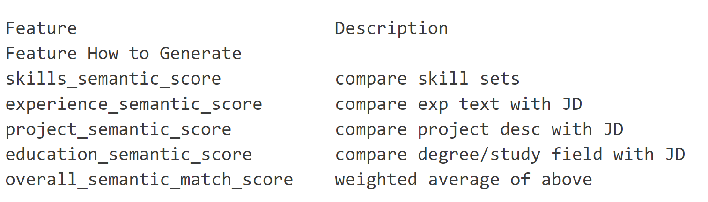
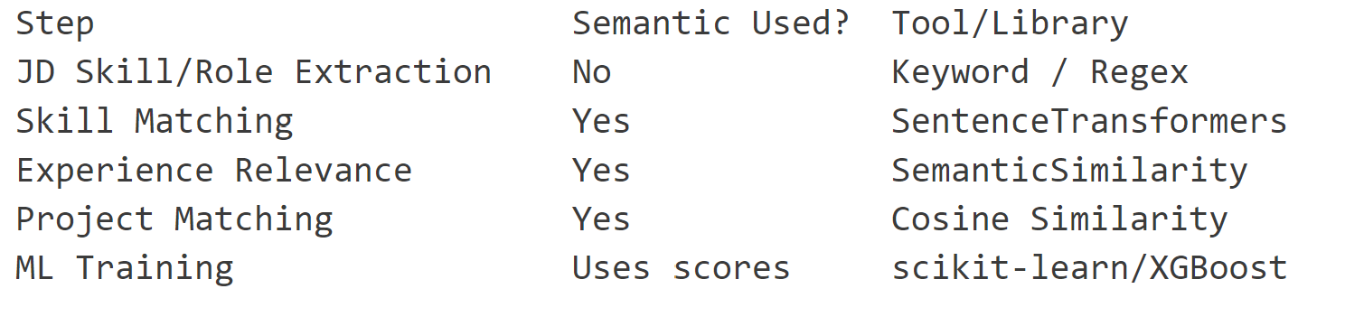
Feature Generation: For each Job-Candidate Pair.
Summary: Sematic Analysis in the Pipeline

Slide 12
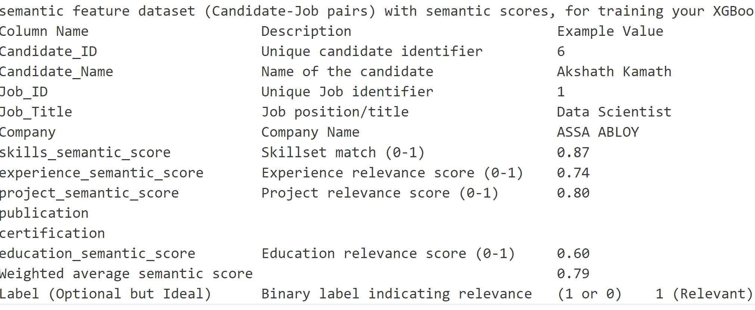
Time to determine (LABEL)Rank of the candidate. Thus, sematic score are required as follows.

Slide 13
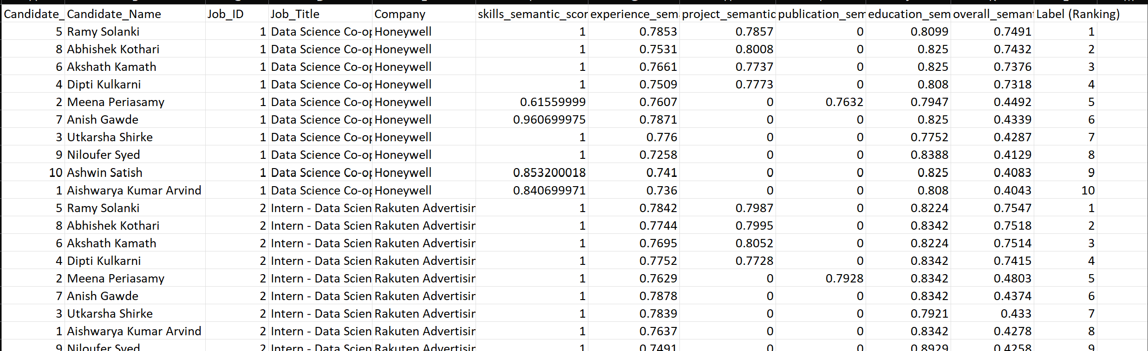
Rank Label for Ranking Logic Generated : Ranks calculated for the candidate listing on leader board

Slide 14
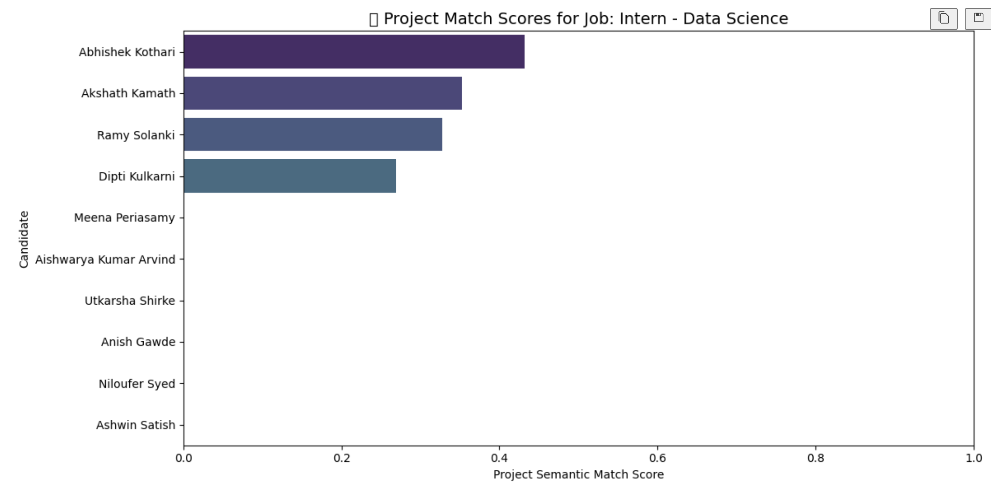
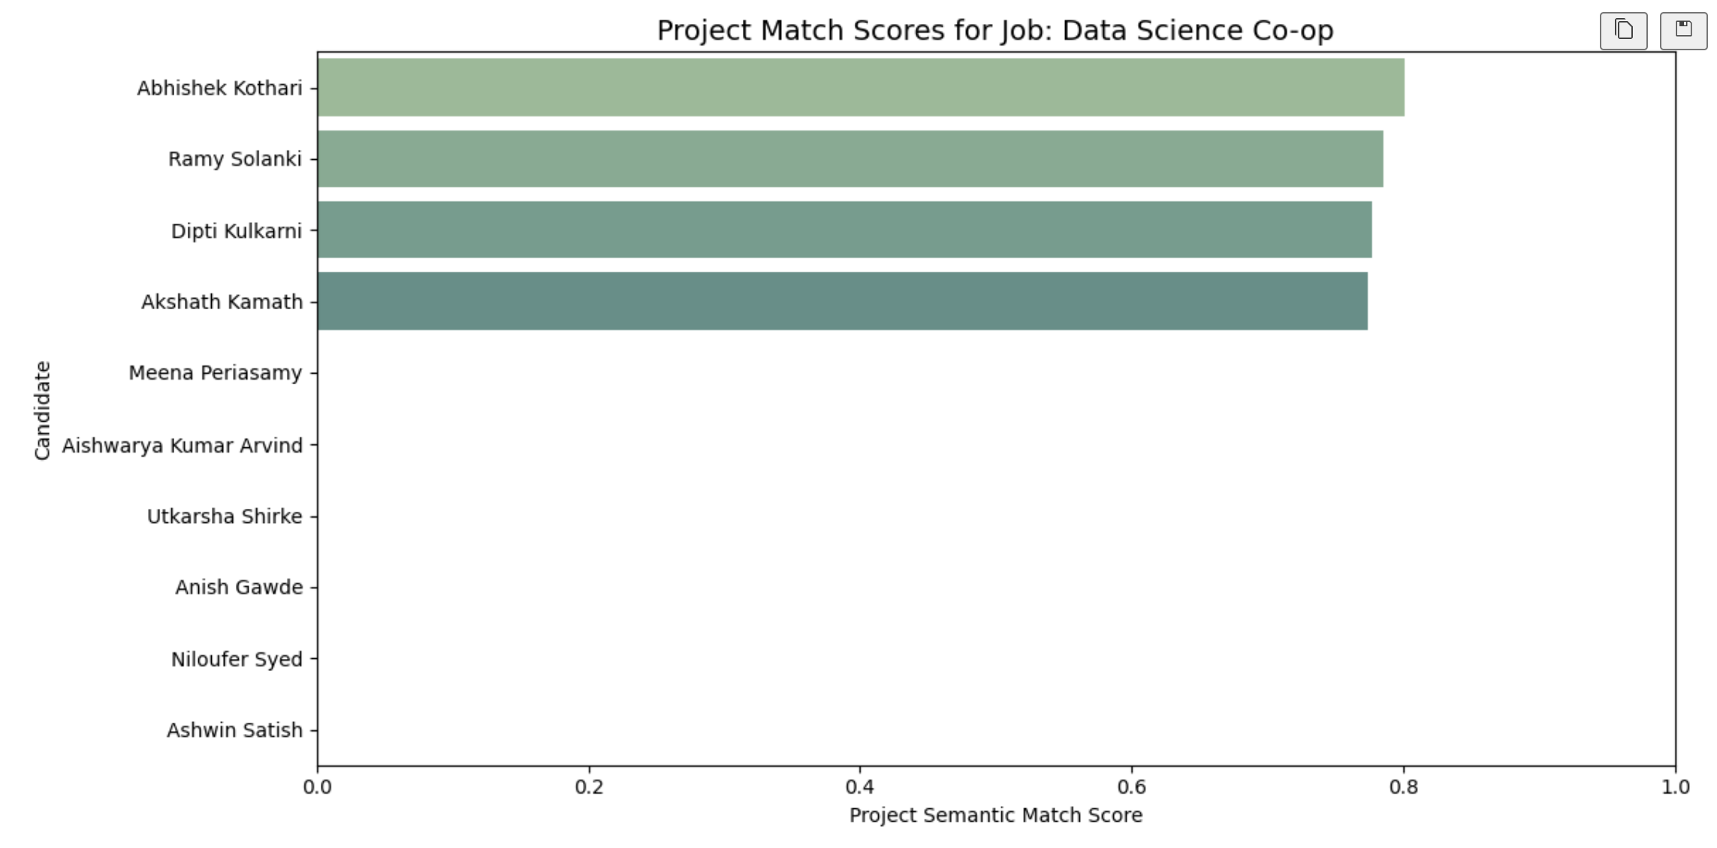
Score Sematic Accuracy Before Data Clearing and logic improvement
Score Sematic Accuracy After Data Clearing and logic improvement

Slide 15
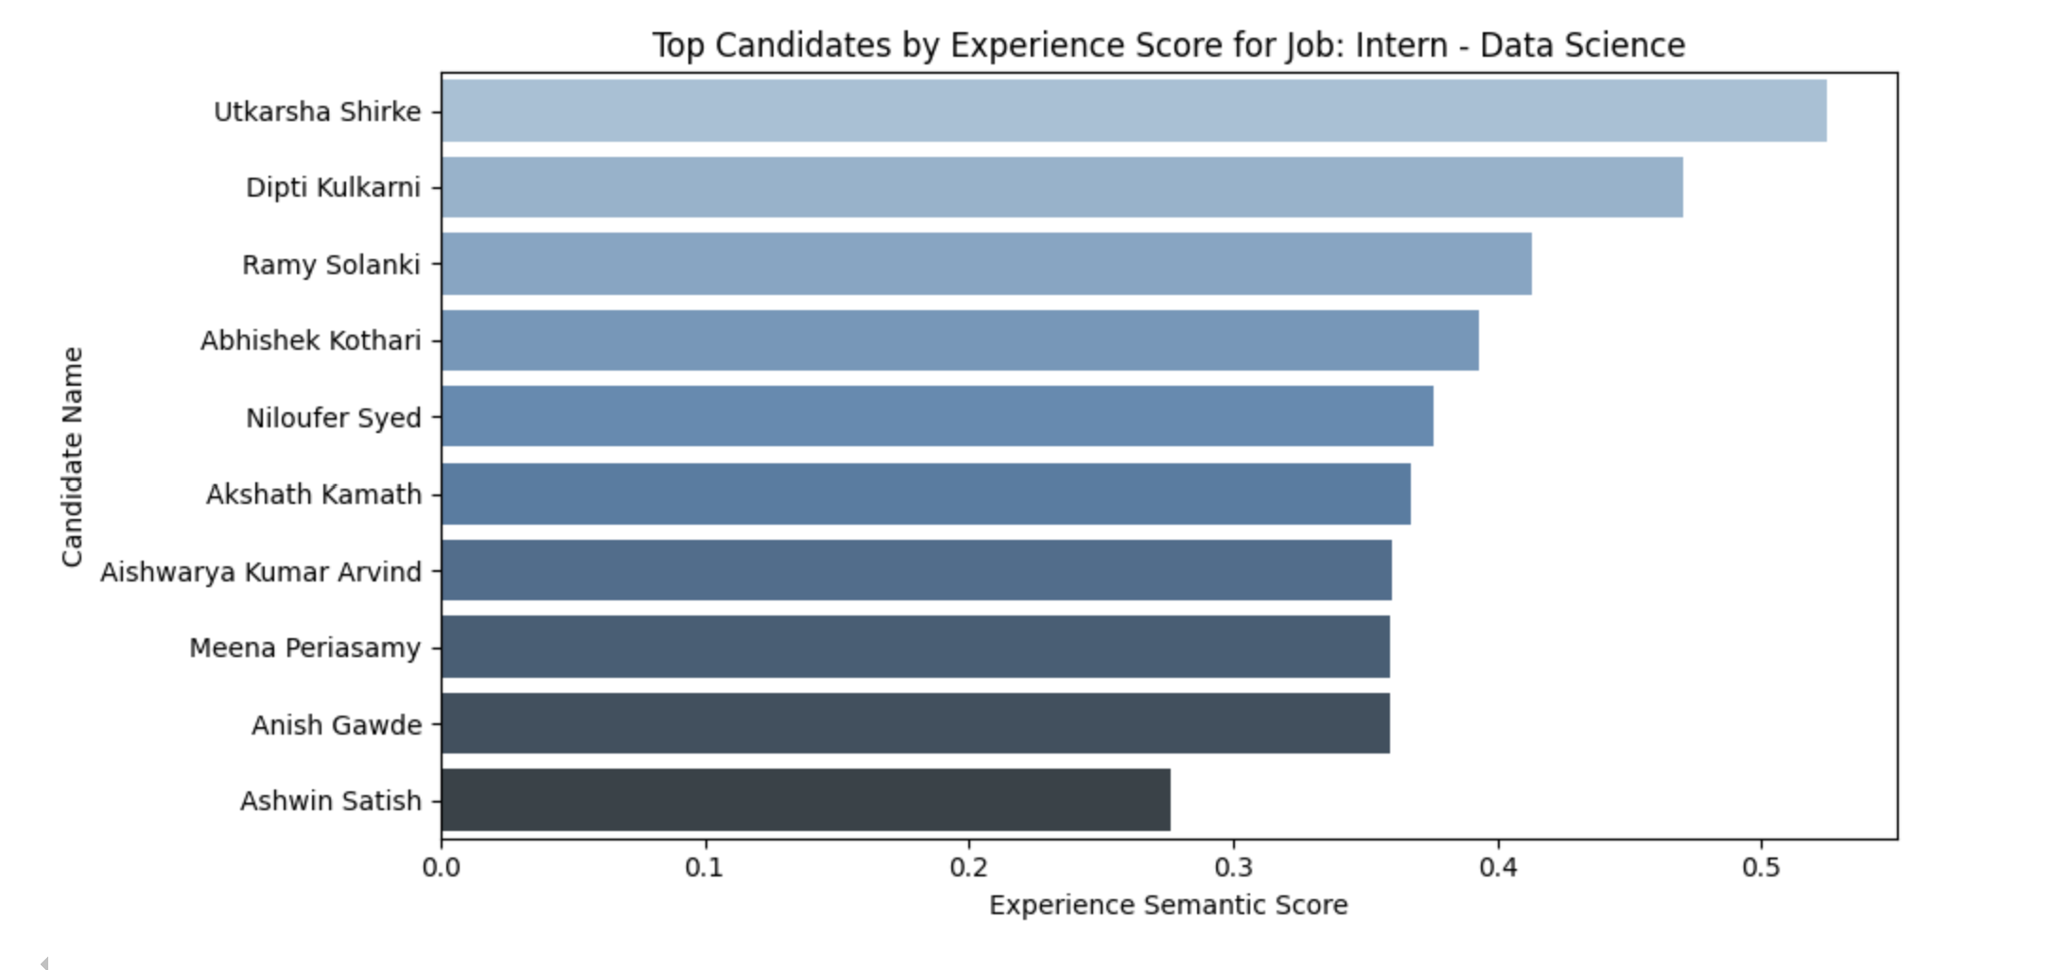
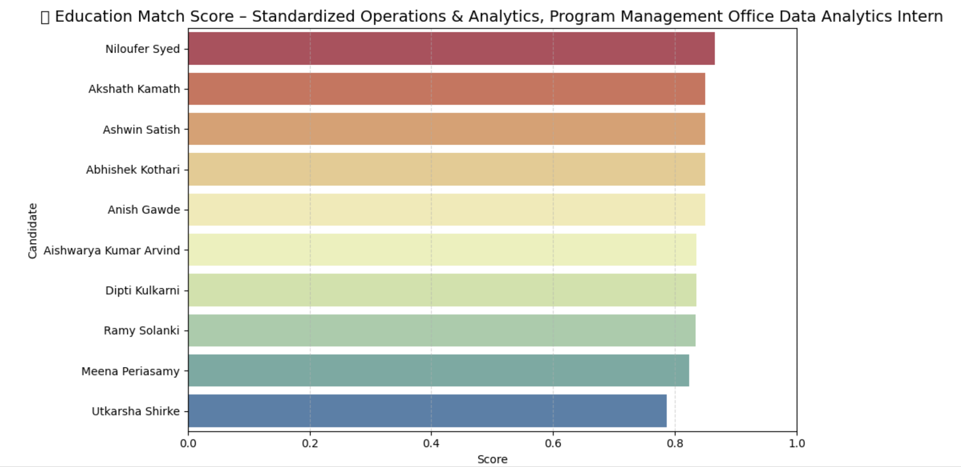
Score Sematic Accuracy Before Data Clearing and logic improvement
Score Sematic Accuracy After Data Clearing and logic improvement

Slide 16

Overall Score Calculation
Weight Distribution:
40% Experience
40% Projects
6.67% Education
6.67% Skills
6.67% Publications
Output Feature: overall_semantic_match_score
Candidates were ranked per job using this final score
column: Label (Ranking).
Weightage distributed amongst sematic scores to calculate over all score for ranking, same as a HR gives importance to any candidate profile.

Slide 17
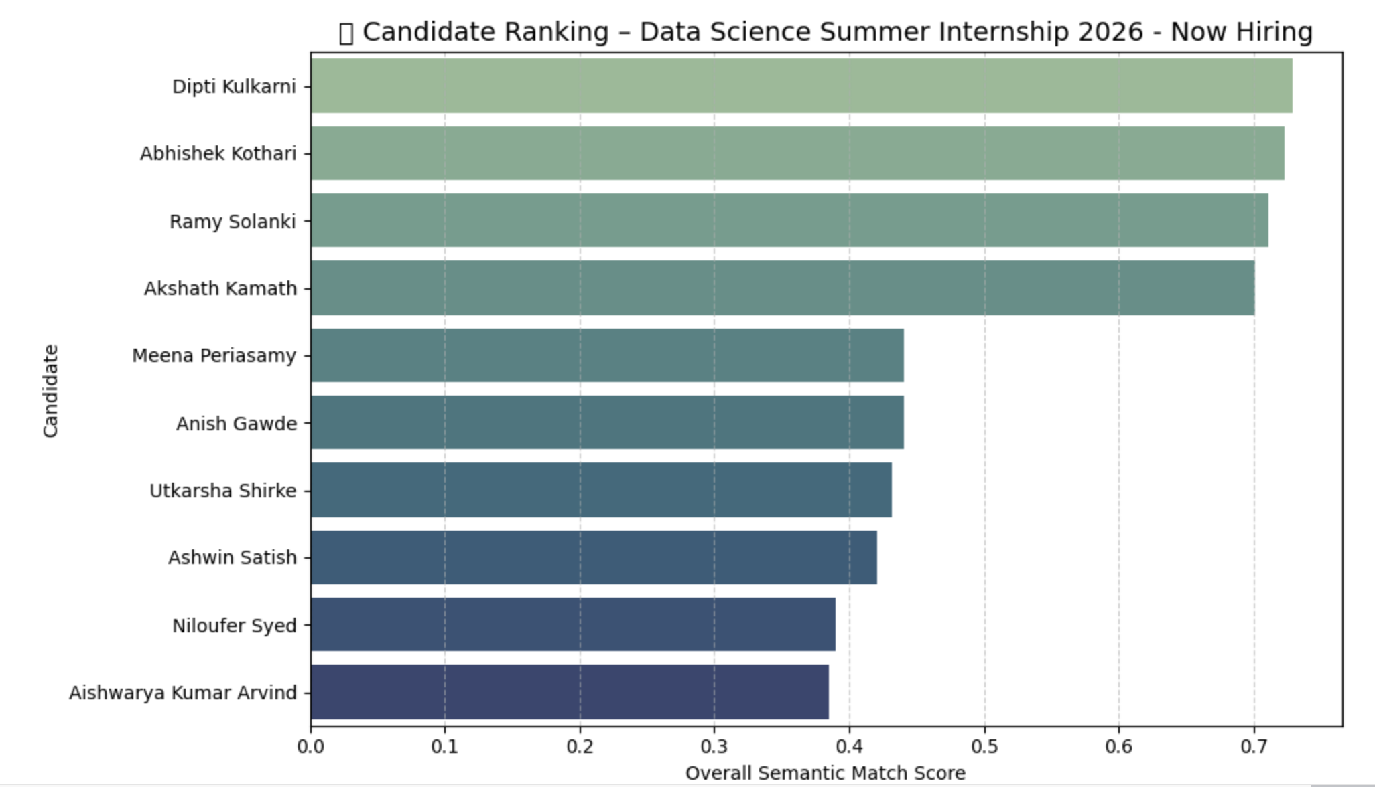

Slide 18
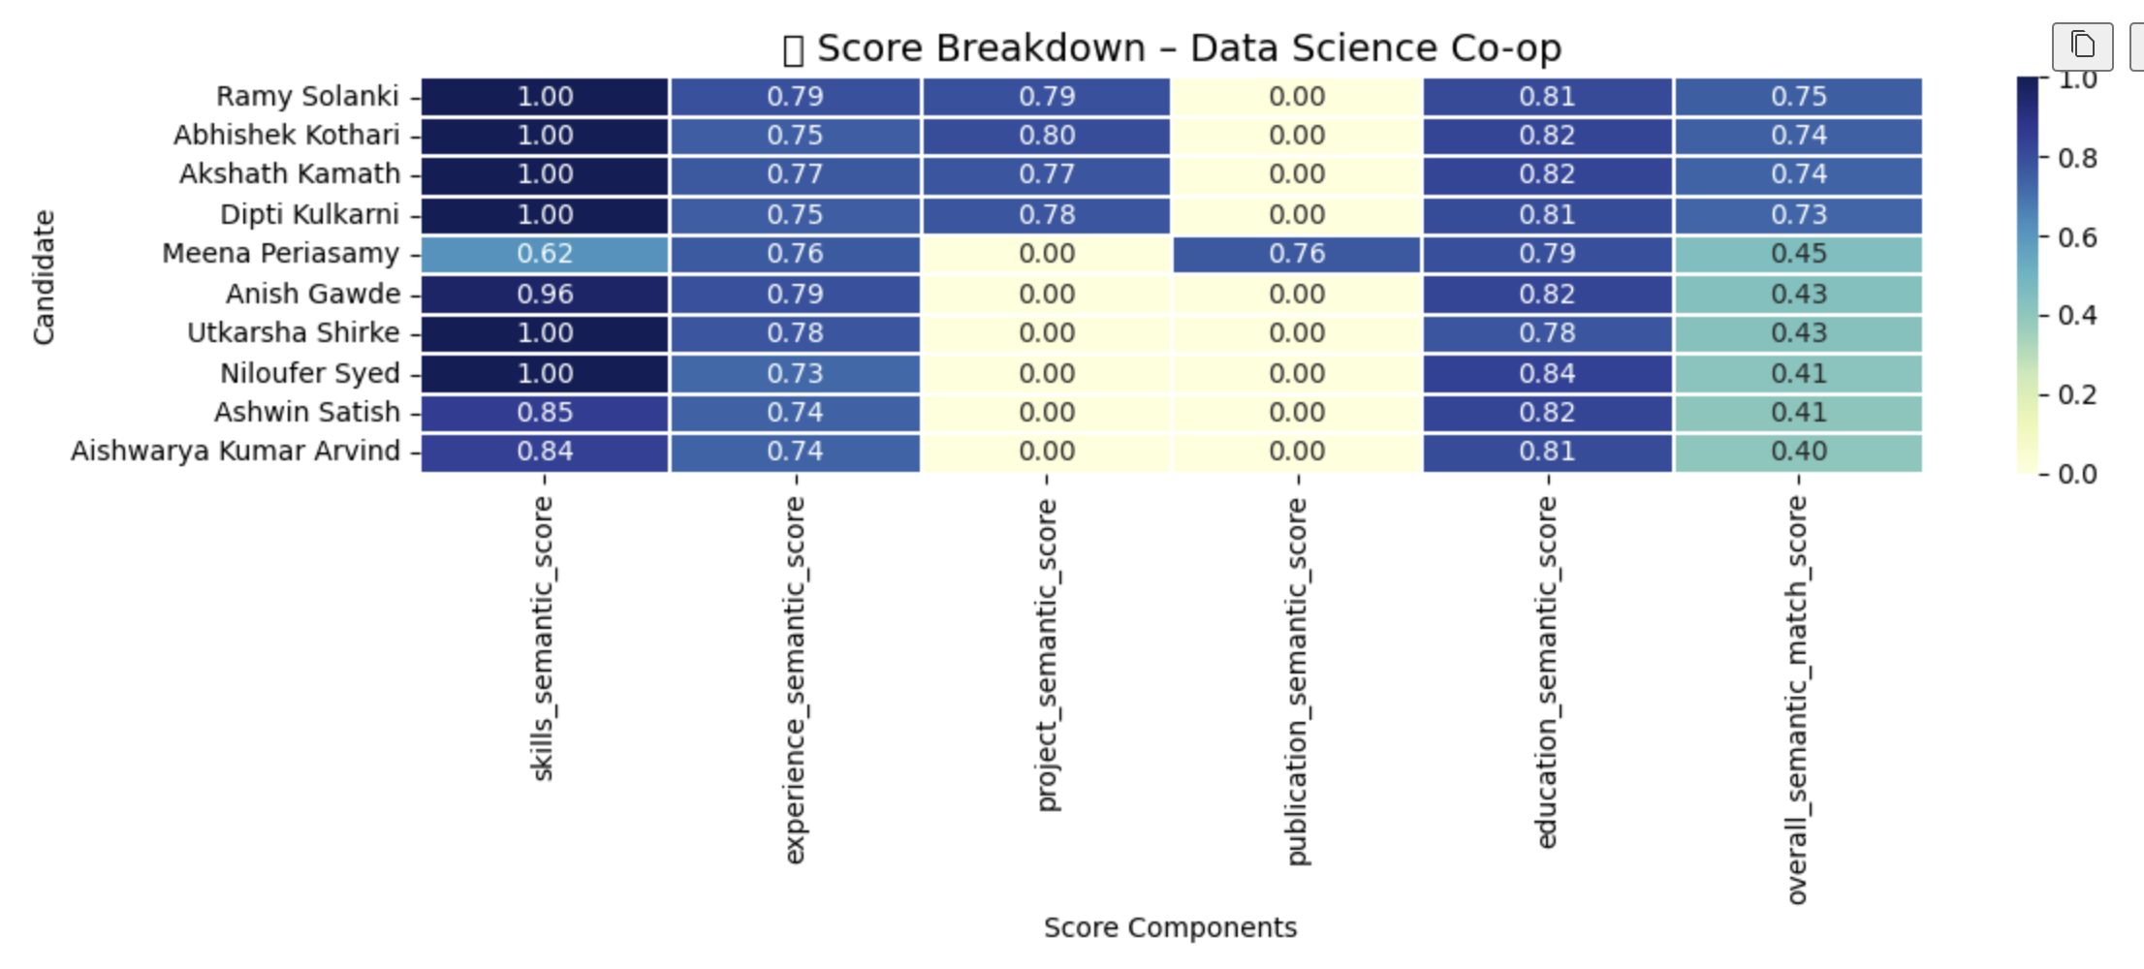

Slide 19
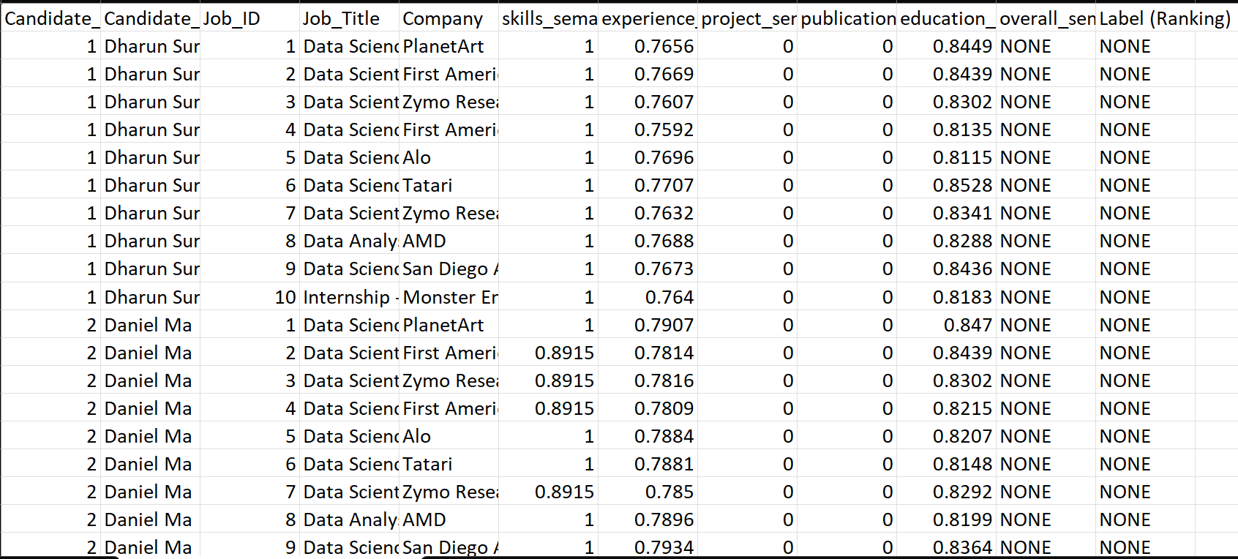
Test Dataset Generation
Created test data with 5 jobs and 5 new candidates.
Applied identical preprocessing
and scoring pipeline.
Left out final rank and overall score
to test model predictions.

Slide 20
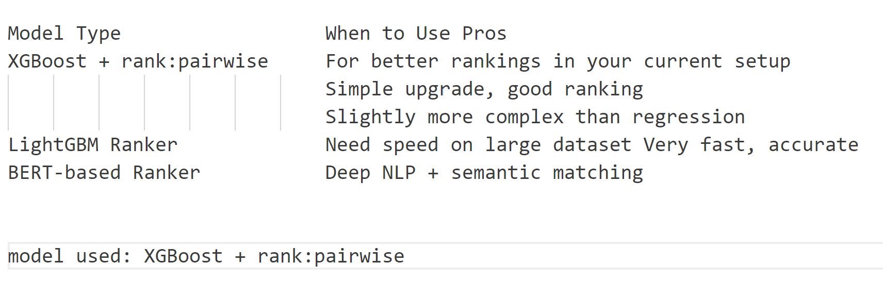
Model Analysis

Slide 21
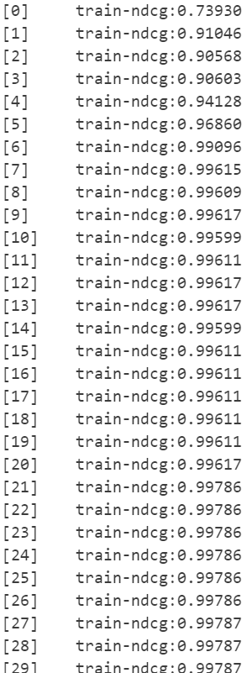
Model Training with XGBoost Ranking
Model Type: XGBoost Gradient Boosted Trees
Objective: rank: pairwise for learning to rank
Evaluation Metric: NDCG (Normalized Discounted Cumulative Gain)
Input Features: Five domain-specific semantic scores
Target Label: Label (Ranking)
Grouping: By Job_ID
Training: 1000 boosting rounds with early stopping
Model Saved As: xgb_ranking_model.ubj

Slide 22
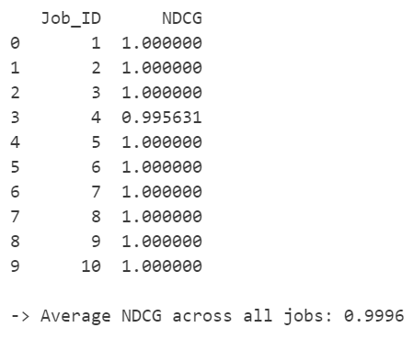
Model Evaluation & Performance
Evaluated using built-in NDCG metric during training.
Observed strong ranking correlation between true and predicted scores.
High interpretability using feature-wise semantic contributions.

Slide 23
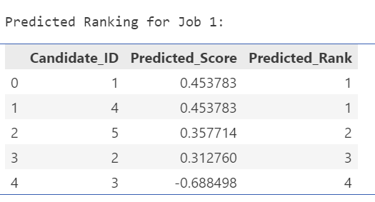
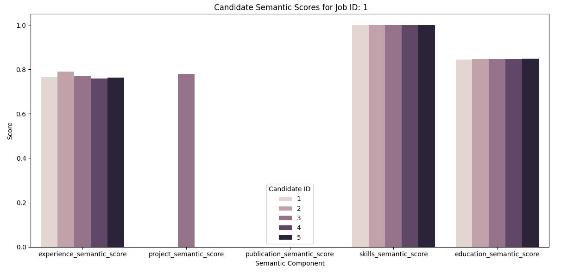
Test Predictions & Visualization
Predictions:
Computed scores and rankings for unseen test candidates.
Visualization:
Candidate vs. Job semantic bar charts (per domain)
Predicted ranks table for each job
Insight: Clear alignment between semantic match and rank predictions

Slide 24
Final Observations & takeaways
End-to-end automated ranking pipeline from raw data to intelligent ranking.
Deep semantic understanding using BERT-based embeddings.
Model-driven ranking using XGBoost pairwise optimization.
Visual, explainable, and scalable system ready for real-world HR tech integration.
Education semantic scoring with ensemble model was heavy on CPU.
Need GPU processing
(e.g.: CUDA).

Slide 25
Design Limitations
Systems Design:
Reading data from Excel: Read is too costly/heavy to handle 1M-1M candidate-job data system may slow down.
Using ensemble modeling: using multiple model for better semantic scoring take time to calculate sematic score. Education Semantic scores calculation ETA 2 hrs. Slows down CPU as runs locally.
Current calculation logic:
break each section data for calculating sematic scores for all the section for each candidate
Calculates overall score and stores to excel
Overall scores read from excel to generate rankings and again stored to excel.
4. No Fall-back mechanism: what if the model fails. The system will suffer hard crash.
5. No Error handling

Slide 26
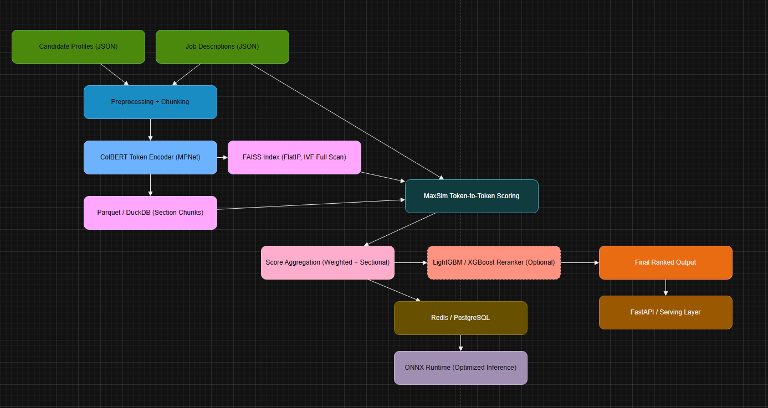
improvements

Slide 27
improvements
1. Added Deep Semantic Granularity with MaxSim
Before: Only high-level document embedding (e.g., Sentence-BERT) Now: Token-level comparison using ColBERT’s MaxSim, capturing word-to-word semantic alignment Improves ranking accuracy by comparing exact responsibilities, skills, and experience line items
2. Introduced FAISS for Scalable Vector Access (without Top-K Filtering)
Before: No scalable vector management or used for Top-K candidate filtering Now: Uses FAISS (FlatIP/IVF) for batch vector access across millions of candidates Allows scoring all candidates, not just retrieving top-K — no silent truncation

Slide 28
improvements
3. Built-in Chunking for >512 Token Limit
Before: No clear handling of long sections Now: Auto-splits long sections (e.g., long experiences) into logical, overlapping chunks Avoids transformer truncation errors and ensures complete data is scored
4. ONNX Runtime for Efficient Model Inference
Before: PyTorch-only inference (slower, GPU-dependent) Now: Integrated ONNX Runtime for fast, lightweight inference across CPU and edge devices Enables low-latency serving at scale and reduces dependency on GPUs

Slide 29
improvements
5. Beginner-Friendly Modular Flow
Before: Technical architecture with unclear flow for non-developers Now: Clean step-by-step explanation for each stage (chunking, scoring, aggregation, reranking) Suitable for product managers, stakeholders, and non-technical collaborators
6. Improved Deployment Strategy & API Layer
Before: Monolithic structure, unclear serving logic Now: Clear flow with FastAPI + ONNX, Redis caching, modular batch processing with Ray Supports parallel processing and 1M × 1M job-candidate scalability

Slide 30
improvements
7. Diagram with Key Design Calls
Job - MaxSim connection
FAISS shown as batch provider (not scorer)
Optional LightGBM/XGBoost re-ranker - The diagram is now a 1:1 match with system logic
8. Fall-back mechanism + Error handling (further enhancements…)

Slide 31
Model - ColBERT’s MaxSim
It does capture semantic meaning between words.
ColBERT breaks both the job description and the candidate section into tokens (which usually correspond to words or sub-words), then:
Encodes each token using a deep transformer (like MPNet or DistilBERT) to get semantic vectors.
For every token in the job query, it finds the most similar token in the candidate section using cosine
similarity.
The maximum similarity values across all token comparisons are summed up (MaxSim = “maximum similarity”).

Slide 32
Model - Example
It does capture semantic meaning between words.
ColBERT breaks both the job description and the candidate section into tokens (which usually correspond to words or sub-words), then:
Encodes each token using a deep transformer (like MPNet or DistilBERT) to get semantic vectors.
For every token in the job query, it finds the most similar token in the candidate section using cosine
similarity.
The maximum similarity values across all token comparisons are summed up (MaxSim = “maximum similarity”).
Link https://docs.google.com/document/d/1hu8-DLsNqh-jfc6xibKBmuC3cssCyXDeBBaHvRFg7gg/edit?usp=sharing

Slide 33
Thank You!
Dhanashree Nerkar | nerkar.d@northeastern.edu

